Slide 1
Key Indicators in predicting a Heart Attack
Arpit Dang
Data Science Institute at Brown University
December 11th, 2024
https://github.com/adang66/Data1030-Project

Slide 2
Recap
What: Telephone surveys among 400k+ American adults that collected variables that may contribute to heart attacks
Who: Collected by the Centers for Disease Control and Prevention (CDC)
When: It was collected in the year 2022 (relatively recent)
The authors removed the data points with missing values leaving 246,022 data points with 39 variables
Target Variable: If the participant had a heart attack; (Yes OR No); making this a classification problem

Slide 3
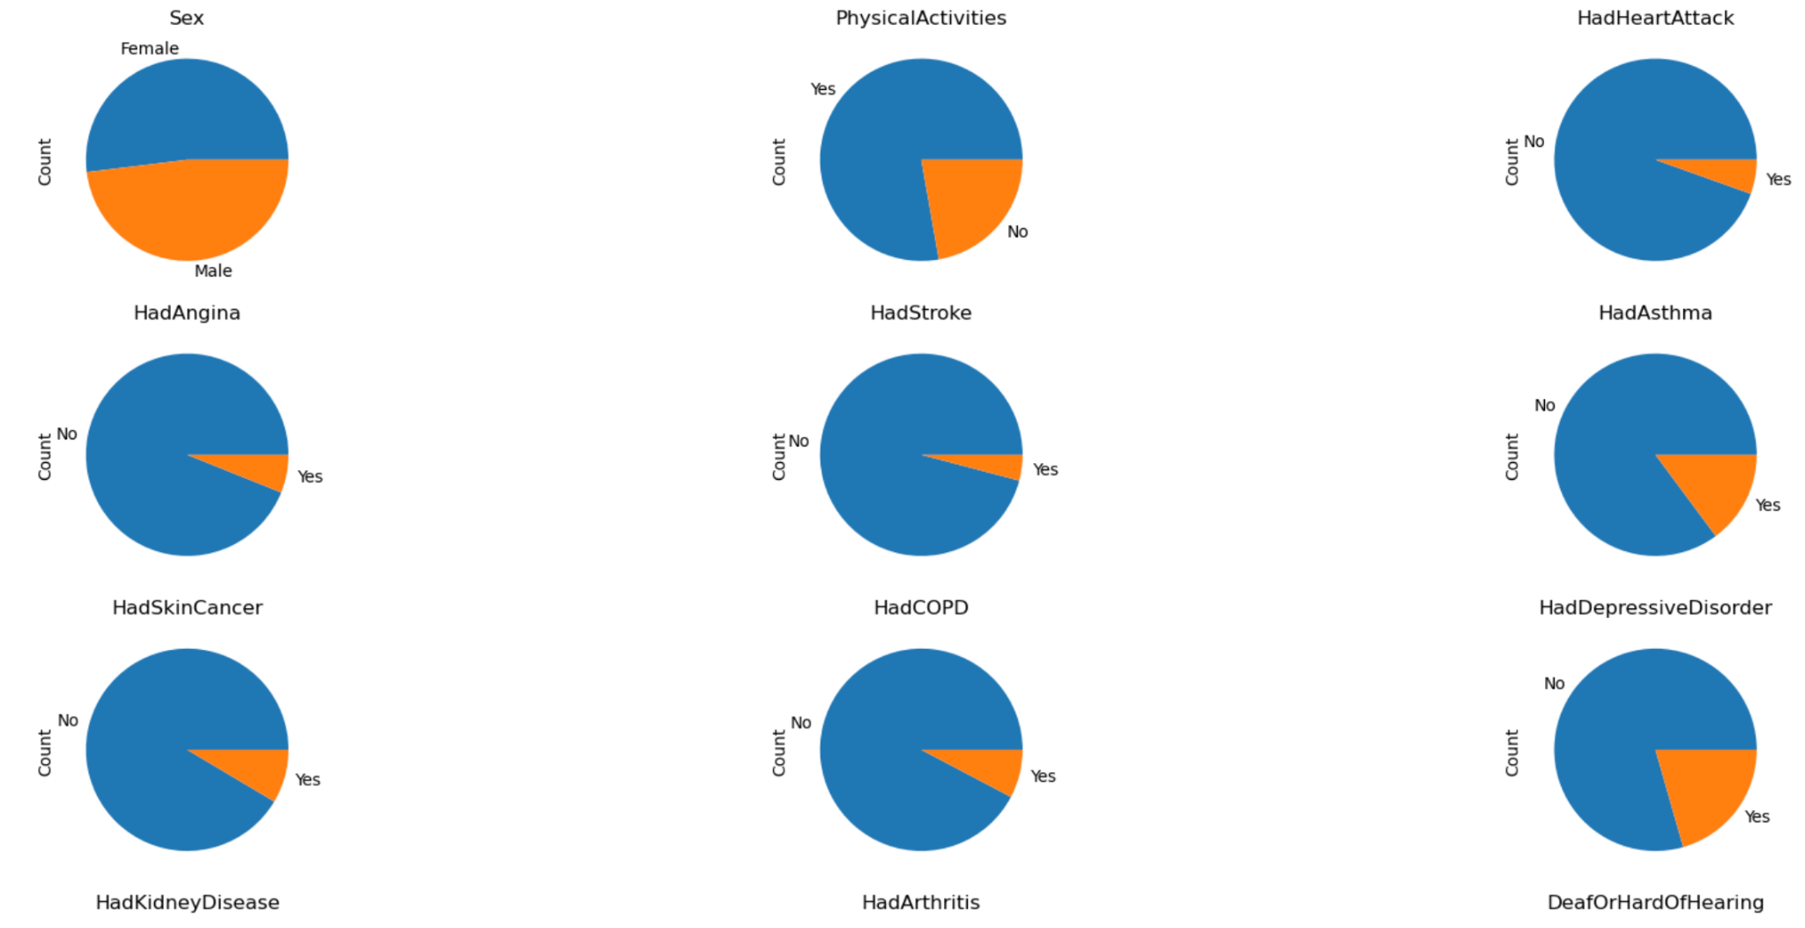
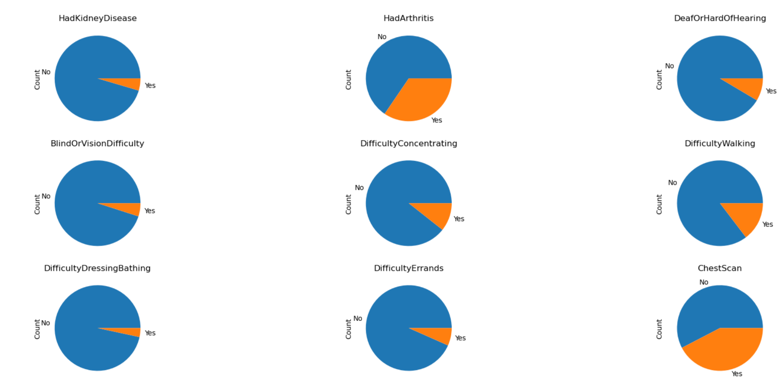
Binary Features
23/39 features are binary features.
Limitation: lack of qualitative data and variability in data, it can lead to reduced model accuracy or interpretability

Slide 4
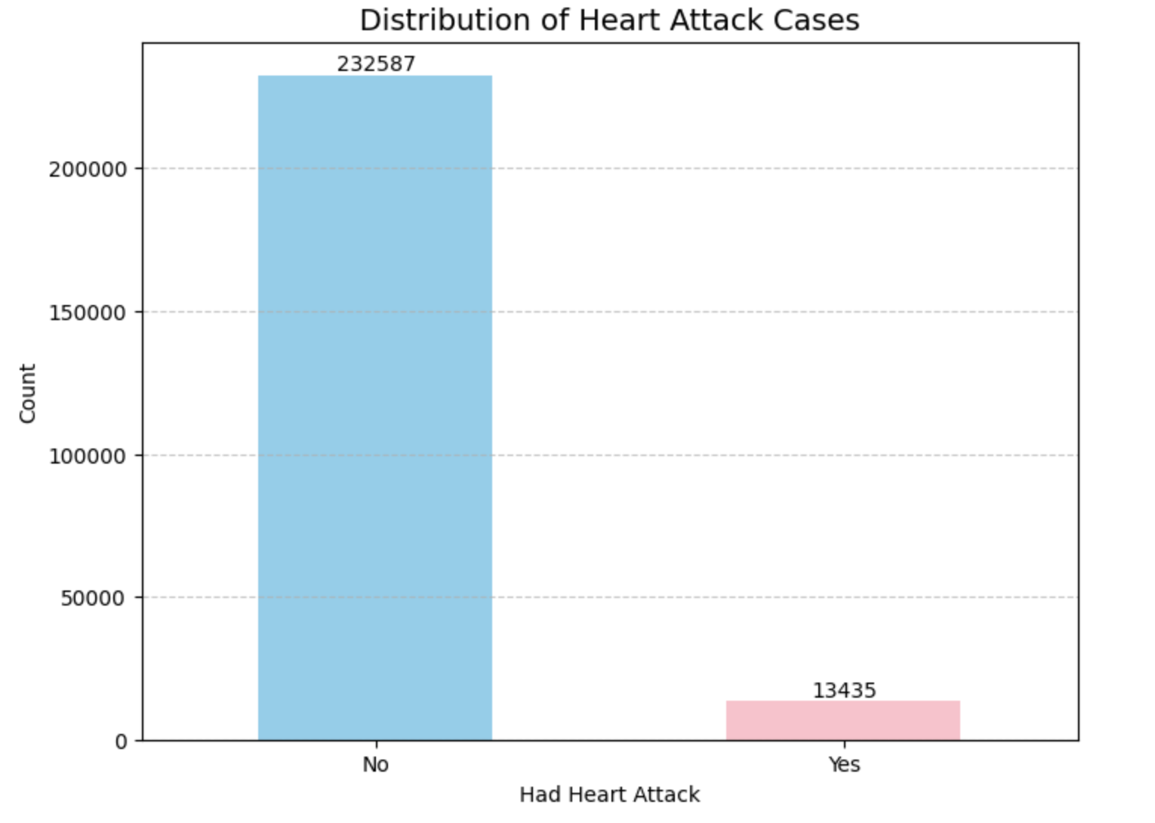
Distribution of Heart Attack Cases (target variable)
5.5% of the participants has an incident of a heart attack, making it an imbalanced dataset
Solution: stratified split
60% training set, 20% validation set, 20% test set

Slide 5
Machine Learning Algorithms
Machine Learning Algorithm | Parameters | ‘class_weight’
Logistic Regression | penalty : [l1, l2, elasticnet (l1_ratio = 0.5)] C : [0.001, 0.01, 0.1, 1, 10, 100] | class_weight = ‘balanced’
Random Forest Classifier | max_depth : [1, 3, 10, 30, 100, 300, None] max_features : [0.25, 0.5, 0.75, 1.0] | class_weight = ‘balanced’
Support Vector Classifier | C : [0.01, 0.1, 1, 10, 100] gamma : [scale, auto] | class_weight = ‘balanced’
XGBoost | learning_rate : [0.001, 0.01, 0.1, 1, 10, 100] gamma : [0, 1, 5, 10, 50, 100] | scale_pos_weight = 17.31

Slide 6
Evaluation Metric for ML algorithms
Because it is an imbalanced dataset, F2 was chosen because it does not take True Negative values into account.
It is also a medical diagnostic problem (where missing a heart attack prediction (FN) is far worse than predicting a heart attack incorrectly (FP)), F2 score was chosen to put more emphasis on recall.
Baseline F2 Score: 0.2241 (Assume that all predicted points belong to ‘Yes’ for ‘HadHeartAttack’)

Slide 7
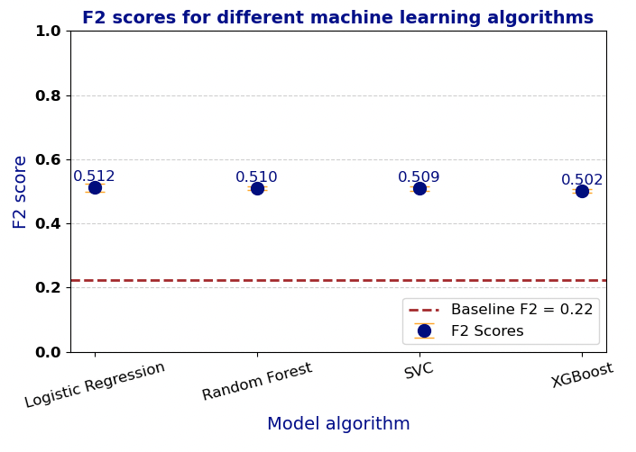
F2 Score for different ML Algorithms
Uncertainties from splitting were addressed by performing the model training and testing over 5 random states.
*20% of the data points were used to train, validate, and test the SVC model (due to the large dataset, and limited computational resources)

Slide 8
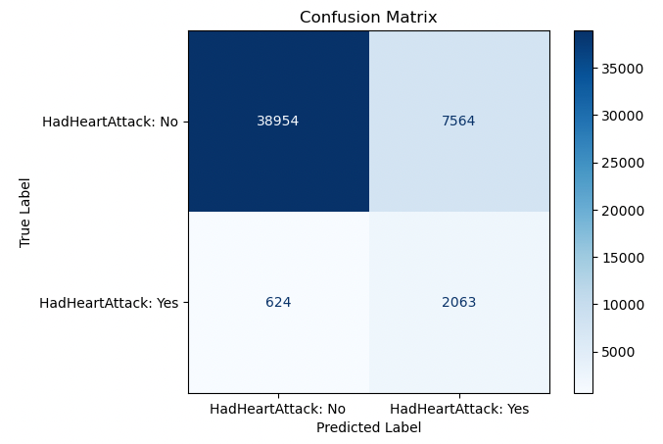
Test Set confusion matrix using the best performing Logistic Regression model
Parameters:
penalty : elasticnet
l1_ratio : 0.5
C : 100 (other C values were 0.1 or 1)
Random_state = 168
Accuracy: 0.8336
Precision: 0.2143
Recall: 0.7678
F1 Score: 0.3351
F2 Score: 0.5312

Slide 9
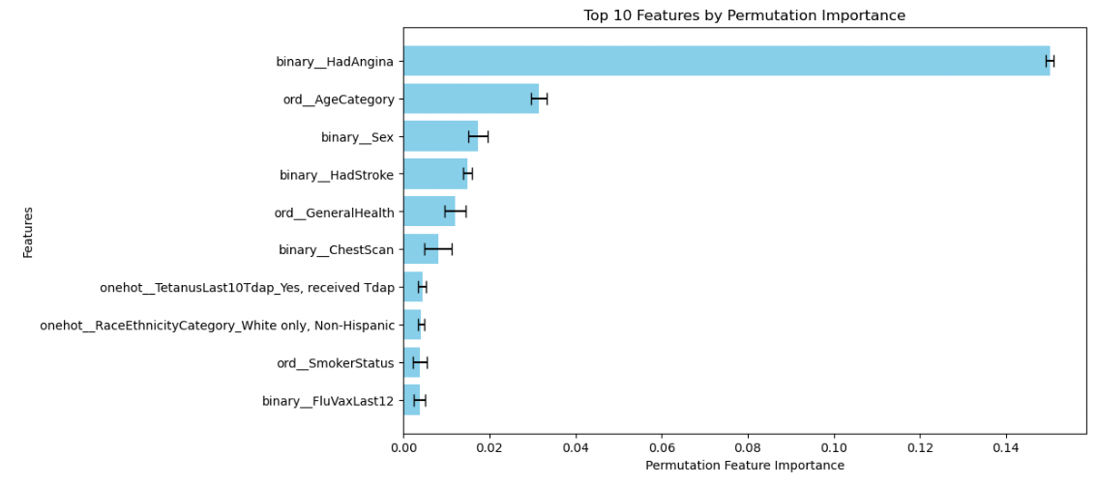
Top 10 most important features according to permutation importance (test set)
Angina (chest pain)[1]
Age (Ranges of age; ordinal not continuous)[2]
Sex [3]
Had a stroke [1]
General Health (Poor, Fair, Good, Very good, Excellent)
Notes:
[1]: S. Mall, "Heart Attack Prediction using Machine Learning Techniques," 2024 4th International Conference on Advance Computing and Innovative Technologies in Engineering (ICACITE), Greater Noida, India, 2024, pp. 1778-1783, doi: 10.1109/ICACITE60783.2024.10617300.
[2]: Pallangyo, P., Mkojera, Z.S., Komba, M. et al. Public knowledge of risk factors and warning signs of heart attack and stroke. Egypt J Neurol Psychiatry Neurosurg 60, 12 (2024). https://doi.org/10.1186/s41983-023-00780-x
[3]: Man, J. J., Beckman, J. A., & Jaffe, I. Z. (2020). Sex as a biological variable in atherosclerosis. Circulation Research, 126(9), 1297–1319. https://doi.org/10.1161/circresaha.120.315930

Slide 10
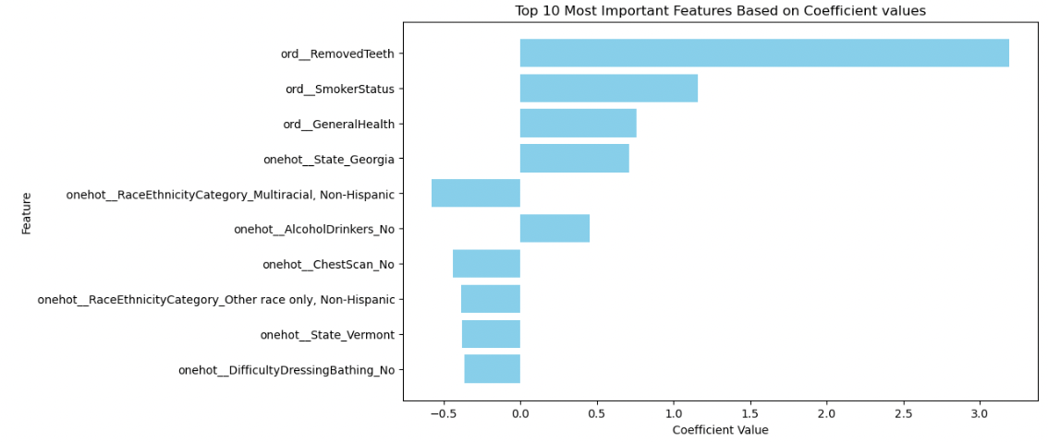
Top 10 most important features according to coefficient values (test set)
Removed Teeth (None of them, 1 to 5, 6 or more but not all, all) [4]
Smoker Status (Never smoked, Former smoker, Current smoker - some days, Current smoker - every day) [2]
General Health
State of Georgia
Notes:
4: Aminoshariae, A., Nosrat, A., Jakovljevic, A., Jaćimović, J., Narasimhan, S., & Nagendrababu, V. (2024b). Tooth loss is a risk factor for cardiovascular disease mortality: A systematic review with Meta-analyses. Journal of Endodontics, 50(10), 1370–1380. https://doi.org/10.1016/j.joen.2024.06.012
2: Pallangyo, P., Mkojera, Z.S., Komba, M. et al. Public knowledge of risk factors and warning signs of heart attack and stroke. Egypt J Neurol Psychiatry Neurosurg 60, 12 (2024). https://doi.org/10.1186/s41983-023-00780-x

Slide 11
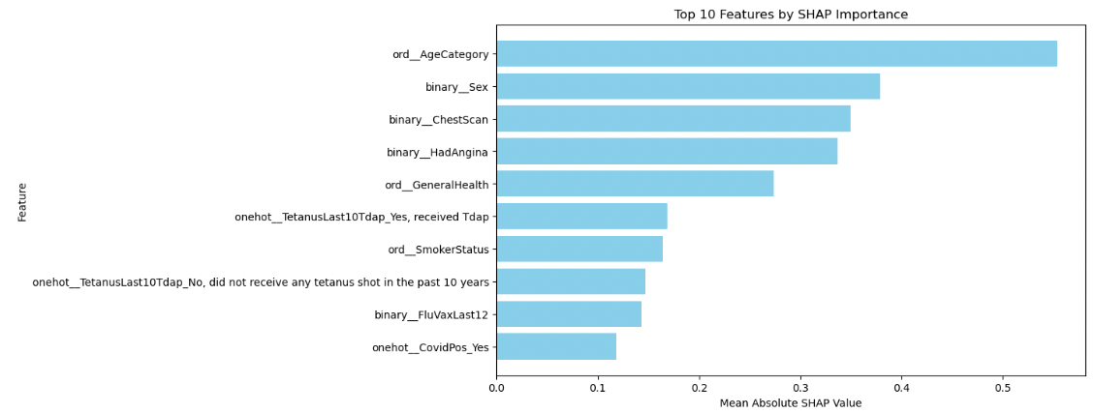
Top 10 most important features according to mean Shap value (test set)
Age
Sex
Chest Scan
Agina (chest pain)
General Health

Slide 12
Some overlap of features that were most important
Age
Angina (chest pain)
Sex
General Health
Smoker Status
Chest Scans

Slide 13
Outlook - how can we improve?
Use other types of machine learning algorithms (K-Nearest Neighbors, Naive Bayes, Bagging Classification, and Boosting Classification)
Maybe put even more emphasis on recall (F3 or F5 Score) because there were still 624 cases in the test set that are False Negatives (1.27%)
Given more computational power, perform the SVC ML algorithm on 100% of the data
Estimate feature importance (permutation/global shap) after dropping correlated variables OR perform a permutations on two features at a time

Slide 14
Thank you for listening!
Questions?

Slide 15
References
Aminoshariae, A., Nosrat, A., Jakovljevic, A., Jaćimović, J., Narasimhan, S., & Nagendrababu, V. (2024b). Tooth loss is a risk factor for cardiovascular disease mortality: A systematic review with Meta-analyses. Journal of Endodontics, 50(10), 1370–1380. https://doi.org/10.1016/j.joen.2024.06.012
Mall, S. (2024). Heart attack prediction using machine learning techniques. 2024 4th International Conference on Advance Computing and Innovative Technologies in Engineering (ICACITE), 1778–1783. https://doi.org/10.1109/icacite60783.2024.10617300
Man, J. J., Beckman, J. A., & Jaffe, I. Z. (2020). Sex as a biological variable in atherosclerosis. Circulation Research, 126(9), 1297–1319. https://doi.org/10.1161/circresaha.120.315930
Pallangyo, P., Mkojera, Z.S., Komba, M. et al. Public knowledge of risk factors and warning signs of heart attack and stroke. Egypt J Neurol Psychiatry Neurosurg 60, 12 (2024). https://doi.org/10.1186/s41983-023-00780-x

